Slide 1



Multi-Sensory Device for Constant Bone Strain Monitoring in Space
Gerardo Figueroa ¹, Efren Barron ², David Gonzalez ², John Szivek ², David Margolis ²
¹ Department of Biomedical Engineering, The University of Arizona, Tucson, Az
² Department of Orthopaedic Surgery, The University of Arizona, Tucson, Az
NASA Space Grant Symposium
Tucson, Az
April 17, 2020

Slide 2
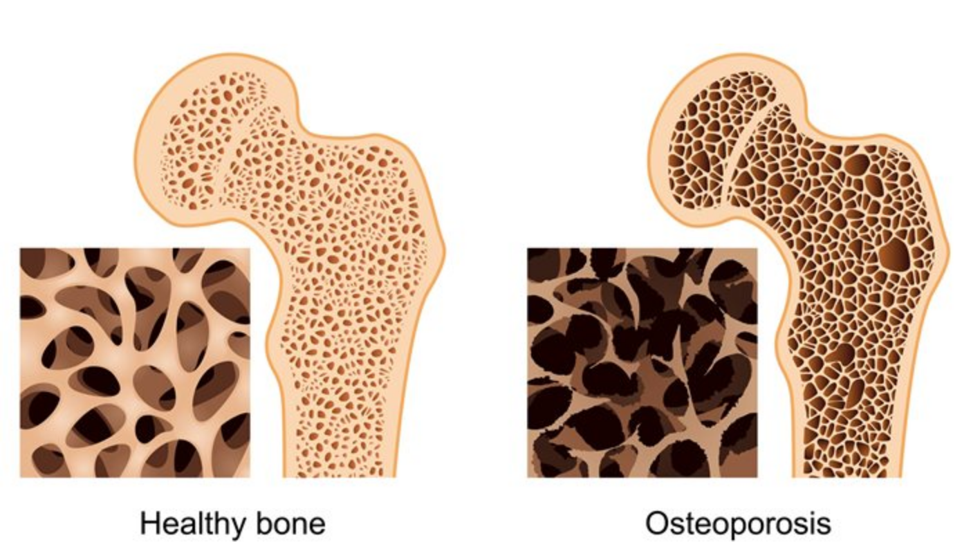
Background
Bone strain is a key regulator of maintaining bone mass and bone healing.
In a microgravity environment, loss of bone mass occurs at different rates in different astronauts causing bone to become porous, similar to that noted in osteoporosis patients.
Previous studies show that calcium phosphate ceramic (CPC) coatings in strain gauges allow for long-term in vivo bone strain measurements.

Slide 3
Goal
An accurate method of obtaining in vivo strain/load measurements is needed to better understand the relationship between bone strain and microgravity to allow astronauts to monitor and adjust their exercise patterns so they can prevent bone loss on long flights.
Create an easily utilized device that will allow instant and long-term bone strain/load measurements from the bones of astronauts in microgravity environments for extended periods.

Slide 4
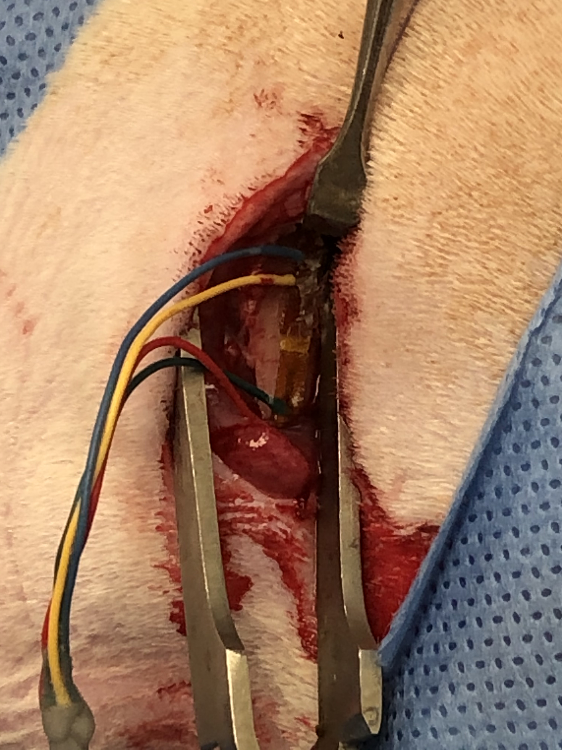
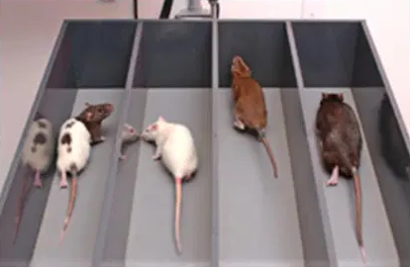
Methods
An implantable device with short-term & long-term strain sensors was surgically implanted on a rat femur.
Rat was placed on a treadmill at normal gait pace to represent average daily strain.
Notes:
OK to mention that the ”short-term” sensor is designed to provide immediate measurements that should become inaccurate within days to weeks while the long term sensor can take up to 6 weeks to show fully accurate measurements.

Slide 5
Results
Post-implantation peak strains were 404με in short-term gauges and 301με in long-term gauges.
3 days post-implantation peak strains were 286με in short-term gauges and 297με in long-term gauges.

Slide 6
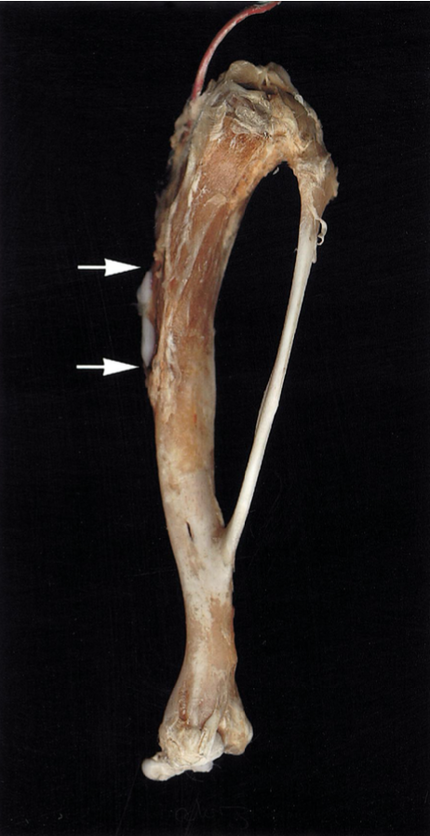
Conclusion and Future Work
Instant strain measurements were recorded immediately post-operatively from both sensors.
Short-term sensors showed decreased peak strains 3days post-operatively.
Further in vivo testing is currently postponed due to COVID-19 pandemic, but 6 weeks of measurements are needed to assess long-term function.

Slide 7
References
1. Szivek, J. A., Anderson, P. L., Wilson, D. L., & Young, D. W. D. (1995). Technical note: Development of a model for study of in vivo bone strains in normal and microgravity environments. Journal of Applied Biomaterials, 6(3), 203–208. doi: 10.1002/jab.770060310
2. Rabkin, B., Szivek, J., Schonfeld, J., & Halloran, B. (2001). Long‐term measurement of bone strain in vivo : The rat tibia. Journal of Biomedical Materials Research, 58(3), 277-281.
3. Dunbar, B. (2015, May 27). Preventing Bone Loss in Space Flight with Prophylactic Use of Bisphosphonate: Health Promotion of the Elderly by Space Medicine Technologies. Retrieved from https://www.nasa.gov/mission_pages/station/research/benefits/bone_loss.html
4. Fan, S. (2013, November 16). Adult Neurogenesis. Retrieved from https://neurorexia.wordpress.com/category/adult-neurogenesis-2/

Slide 8
Questions?
Gerardo Figueroa
gerardofigueroa@email.arizona.edu

